Slide 1

  Year 2 Curriculum Meeting
  Wednesday 25th June 2025

Slide 2
Meet the staff
Year 3 / 4 team
Droxford Base: Miss Barker
Hambledon Base: Mrs Willcocks/Miss Barnett
Meonstoke Base: Miss Bond
SENCo – Mrs Burrell

Slide 3
Our Aims

Slide 4
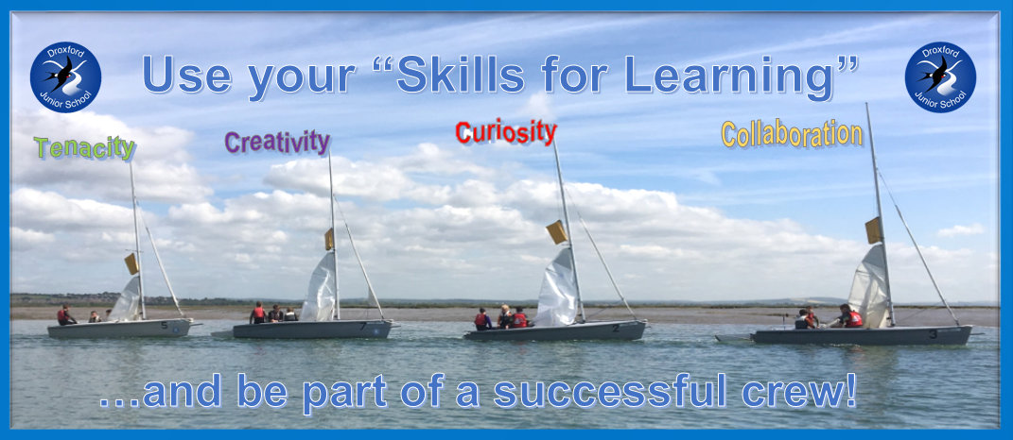

Slide 5

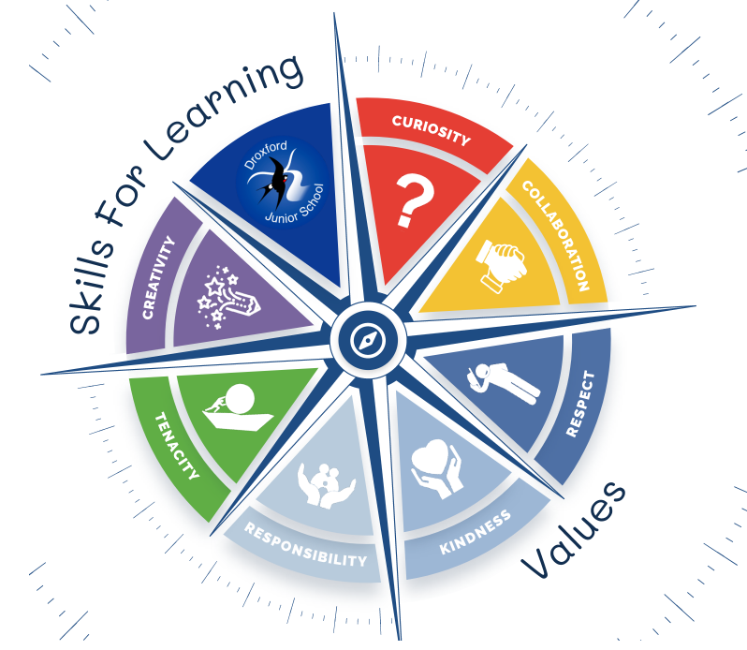

School Vision
Equipping our children with the knowledge and skills to navigate life successfully.

Slide 6
Start of term - September
First two weeks
Year 4 Buddy
Children working on a two week-long project based on a book.
Baseline assessments.
Opportunity on the Friday 12th September 10:45-12:30 for parents to come in and work with their children & have lunch.
PE lessons – children come in to school wearing kit – no trainers on other days – you will be notified about which day your child has PE
All clothing named please!

Slide 7
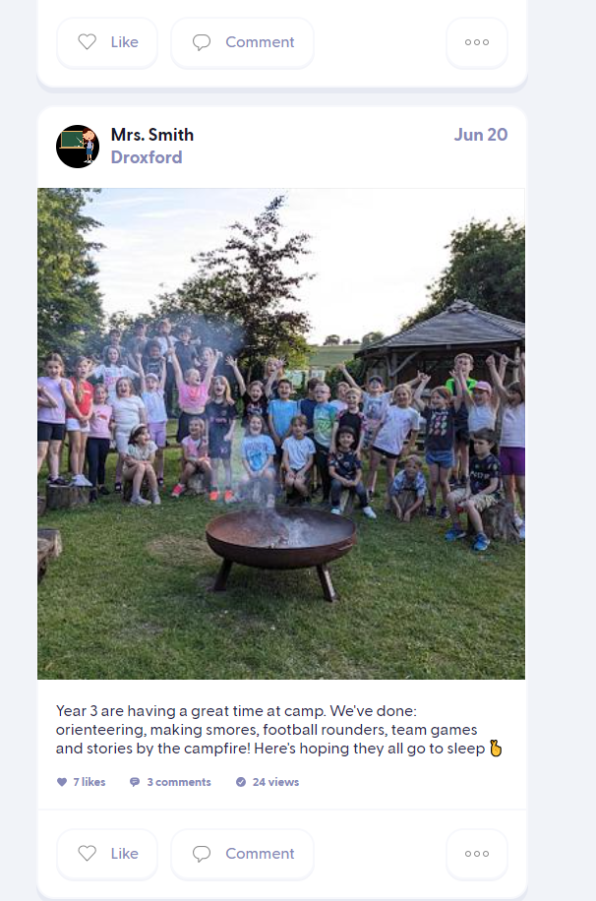
Communication
Emails via the Admin Office
Phone calls
Meet with teachers
Class Dojo

Slide 8
2 Year Cycle
Follows a cycle
The exception is Maths
May have different classes for maths
Boosters and Interventions
SEN- adapted curriculum

Slide 9
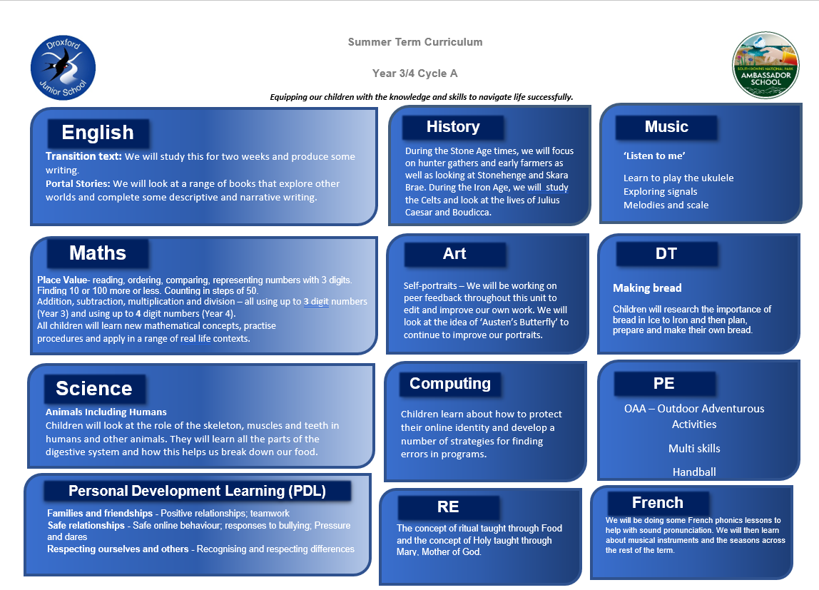
Autumn curriculum overview
S

Slide 10
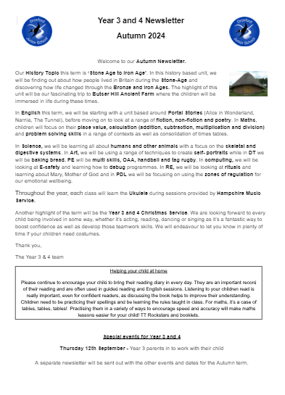
Termly Year 3 / 4 curriculum newsletter
B

Slide 11

Reading
Children encouraged to read at least 5 times a week for 15 minutes
More ownership on child to select books
Choose a reading book from central library or Learning Base libraries- two books can be taken out a time.
Use a reading diary supplied, termly, by the school. Expectations are that it is used to record progress over time – useful for a range of vocabulary.
Please ensure you are checking your child’s reading and signing their diary weekly.
J

Slide 12
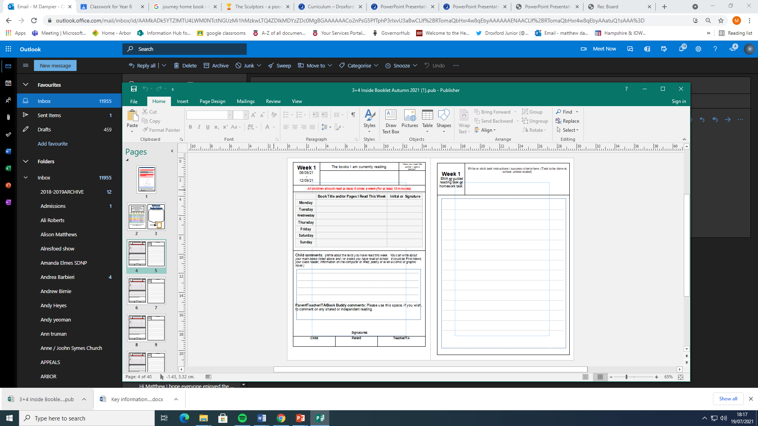
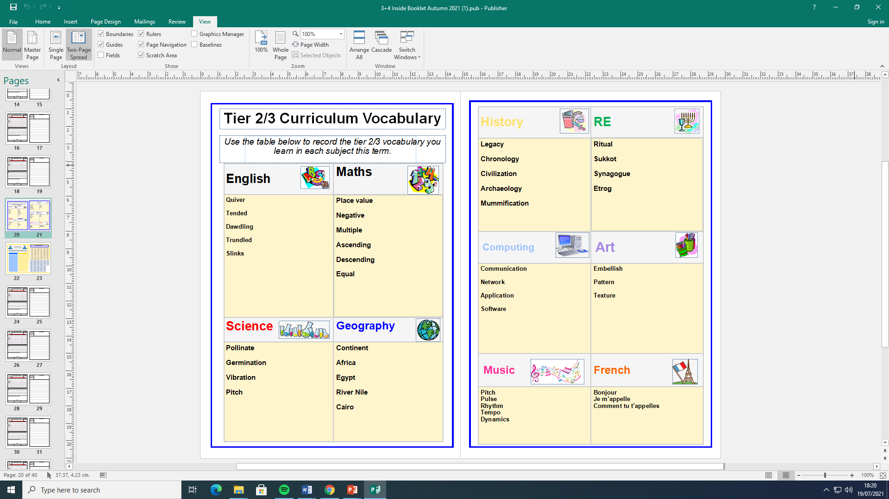
J

Slide 13

Spelling and Phonics
In line with infant schools
Read Write Inc for spellings- in groups based on spelling need
Mainly taught by teaching assistants
The Read Write Inc Phonics for those that need it
Taught by teachers and teaching assistants

Slide 14
Homework
Consolidates learning happening in class
Each child will get a Homework Folder – English, Maths and / or Foundation subject work.
Homework will be given out every Wednesday
We also have a Reading Diary and Times Table Booklet as well as weekly spellings.
B

Slide 15
‘Changeover day’ – Thursday 3rd July
  Children arrive at 9.15
  Go to the hall to meet new learning base teacher and are registered
  Children will go with new learning base teacher to meet Year 4 children (current Year 3)
  Children work all day in new classes
  Series of tasks for purpose of getting to know each other
  Guided tours by the older children
  Children either bring a packed lunch, or have a school dinner (please let the office know in advance)
  Afternoon task
  Parents collect children at 2.30 from the playground
J

Slide 16
New ‘Learning bases’
Children have been placed in each Learning base (named after local villages) with at least one other child from their feeder school that their current teacher thinks they will work well with.
An even split of Year 3 and Year 4 children.
An even split of boys and girls.
As well as learning bases children will have opportunities throughout the year to work with other classes.
Feel free to leave when you are ready.
Thank you!
Meonstoke, Hambledon or Droxford?

Slide 17
The School Day
Gates open at 8:40 with children going into classes at 8:55 to register.
15 minute break at 10:15-10:30
1 hour lunch at 12-1pm
End of Day 3:30
Children can walk down to the square (supervised)
Some get the bus
Some go to clubs
You can park and meet the children outside school
Please ensure your child knows how they are getting home

Slide 18
Clubs
Breakfast club every day from 7:30
After school clubs run every day from 3:30-4:30
‘4:30 club’ runs Tues, Wed, Thurs (4:30-5:30)

