Slide 1

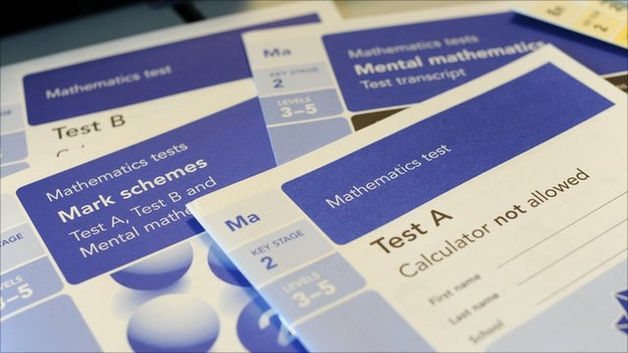

2023
SATs
Notes:
B

Slide 2
SATs
Our priority is always the happiness of your children and we want them to think of the week as any other week.
We want the children to be as calm as possible which is why we practise the tests.
The children have also been working extremely hard and we want them to have a sense of pride when they receive their results
Notes:
J

Slide 3

Year 6 Structure
Spring Term:
Mock SATs
Gathering Writing Evidence
Split certain lessons on need
Summer:
SATs
Class Split
Writing Evidence gathered until the end of June
Year 6 Performance
Transition
Leavers
Notes:
A

Slide 4
Transition and Data
At some secondary school, some sets are decided on scaled scores (has/has not met) from SATs,
Secondary look back at SATs strands that children did less well in and booster them,
They can also see test scripts.
Notes:
J

Slide 5
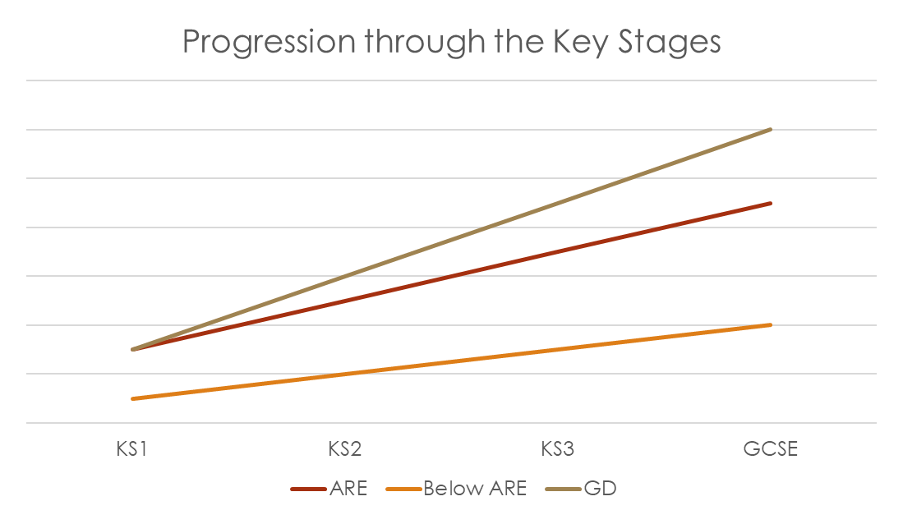
Beyond SATs
Keeping on track at this point is vital…ARE at KS2 should equate to level 4 (previous grade C) at GCSE.
KS2 data is not just about accountability for Primaries and Junior.
Notes:
J

Slide 6
The Timetable
Monday 8th- Bank holiday
Tuesday 9th – SPAG: Punctuation & Grammar (45mins) and Spelling (approx. 20mins)
Wednesday 10th –Reading (1 hour)
Thursday 11th – Arithmetic (30mins) and Maths Reasoning 1 (40mins)
Friday 12th – Maths Reasoning 2 (40mins)
Notes:
A

Slide 7

Marking and Scores
These tests will be both set and marked externally, and the results will be used to measure the school’s performance.
A raw score is given to the children and then this is standardised across the nation.
A pass mark is 100 (scaled score).
A high scaled score is over 110.
Teacher assessments in writing
You will get these results at the end of July
Notes:
A

Slide 8
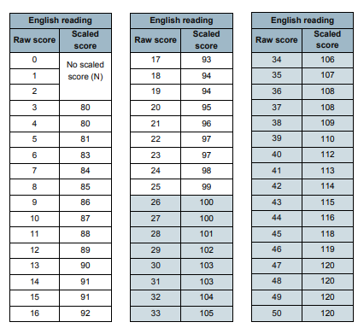
Notes:
A

Slide 9
The SATs Week
Breakfast is held at school (details to follow.)
Most of the children will sit the test in their classroom.
Some will sit the test in the ICT suite or in other rooms (this will be based upon what is best for the individual child.)
A small number of children will have a reader and/or have extra time.
In order to have a reader or have extra time, the child’s reading age has to be at least 2 years below their actual age or they need to meet other specific criteria.
All other children can have questions read to them but they must ask for this (excluding Reading paper).
In the afternoon, they may go to the recreation ground and do some tasks for the following test.
Fun Farm Day (date to follow)
Last year lots of children said it was their best week of the year.
Notes:
J

Slide 10
The Individual Papers
Notes:
A

Slide 11

The KS2 reading test
Single paper with three passages of text.
One hour long, including reading time.
There will be a selection of question types, including:
Ranking/ordering, e.g. ‘Number the events below to show the order in which they happen in the story’
Labelling, e.g. ‘Label the text to show the title of the story’
Find and copy, e.g. ‘Find and copy one word that suggests what the weather is like in the story’
Short constructed response, e.g. ‘What does the bear eat?’
Open-ended response, e.g. ‘Look at the sentence that begins ‘Once upon a time. How does the writer increase the tension throughout this paragraph? Explain fully, referring to the text in your answer.’
Notes:
A

Slide 12
Comprehension Skills
Retrieval of facts: finding specific information.
Inference and deduction: reading between the lines.
Identifying and understanding language: words in context, writer’s choice of words.
Summarising: main ideas from more than one paragraph.
Making predictions: what may happen.
Understanding the text as a whole: sequence of events or making comparisons.
USE EVIDENCE TO SUPPORT ANSWERS
Notes:
A

Slide 13

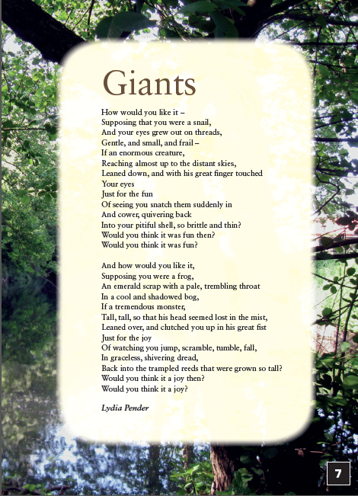
Sample KS2 Reading Texts
Notes:
A

Slide 14
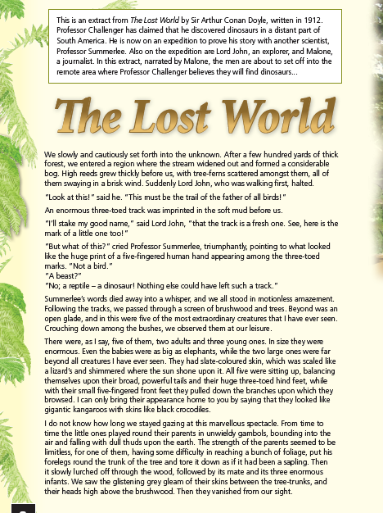
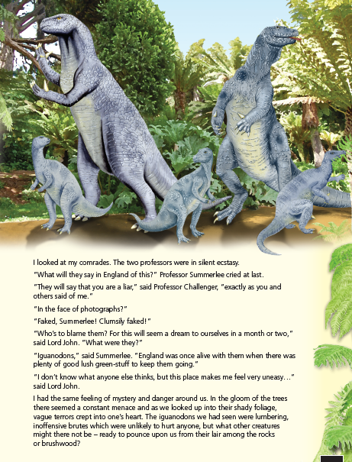
Sample KS2 Reading Texts
Notes:
A

Slide 15
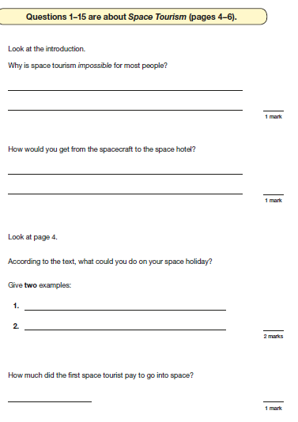
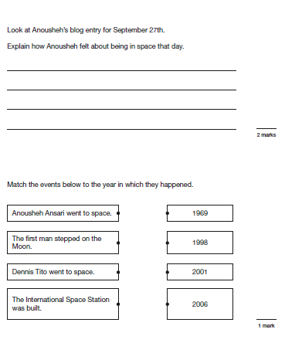
Sample KS2 Reading questions
Notes:
A

Slide 16
How to support your child with Reading
Read with your child: get your child to read aloud to you, and then ask them questions such as the examples given previously.
Foster a love of reading.
Read little and often.
Read a range of genres: poetry, fiction, non-fiction, newspapers
Read aloud to your child whilst your child follows the text: listening is an important part of reading; it will help your child learn the importance of punctuation and reading with expression.
Get them to read at pace- time them!
Notes:
A

Slide 17
The KS2 grammar, punctuation and spelling test
2 parts
Grammar paper (45 minutes)
Aural spelling test of 20 words, lasting around 15 minutes (read by school staff.)
The grammar and punctuation test will include two sub-types of questions:
Selected response, e.g. ‘Identify the adjectives in the sentence below.’
Constructed response, e.g. ‘Correct/complete/rewrite the sentence below,’ or, ‘The sentence below has an apostrophe missing. Explain why it needs an apostrophe.’
Notes:
J

Slide 18
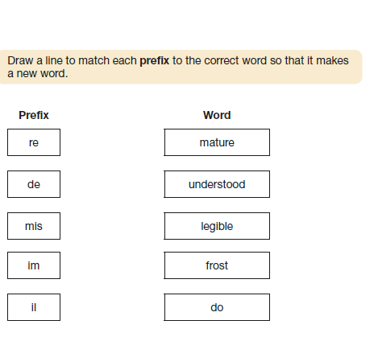
Sample KS2 Grammar questions
Notes:
J

Slide 19
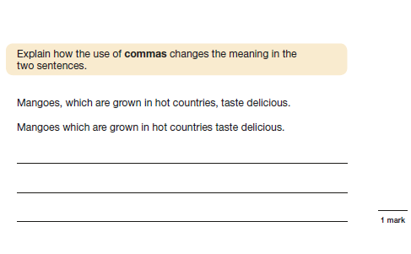
Sample KS2 Grammar questions
Notes:
J

Slide 20

How to support your child with Grammar, spelling and punctuation
Help your child learn the spellings that are sent home
When reading to and/or with your child discuss they use of punctuation (inverted commas to mark speech, the use of parenthesis (brackets) to add additional information, the use of capital letters) etc.
Revision books. Unfortunately, the grammar paper relies on a child knowing the terminology e.g. subordinate clause, main clause, adjective, article, passive, active – and many more.
CPG and Rising Stars publish some good texts.
Support with homework sent home.
Notes:
J

Slide 21

The KS2 Maths Test
Children will sit three papers in maths:
Paper 1: arithmetic, 30 minutes. Fixed response questions, where children have to give the correct answer. These are all calculation based.
Papers 2 and 3: reasoning, 40 minutes per paper
Papers 2 and 3 will involve a number of question types, including:
Multiple choice
True or false
Constrained questions, e.g. giving the answer to a calculation, drawing a shape or completing a table or chart
Less constrained questions, where children will have to explain their approach for solving a problem
Notes:
J

Slide 22
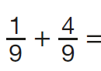
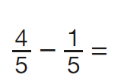
Sample KS2 maths arithmetic questions
6.1 + 0.3 =
5 × 4 × 7 =
4² =
1,440 ÷ 12 =
630 ÷ 9 =
1,034 + 586 =
20% of 1,500 =
2.5 + 0.05 =
24 × 3 =
100 × 100 =
48 ÷ 6 =
1.28 × 100 =
Notes:
J

Slide 23
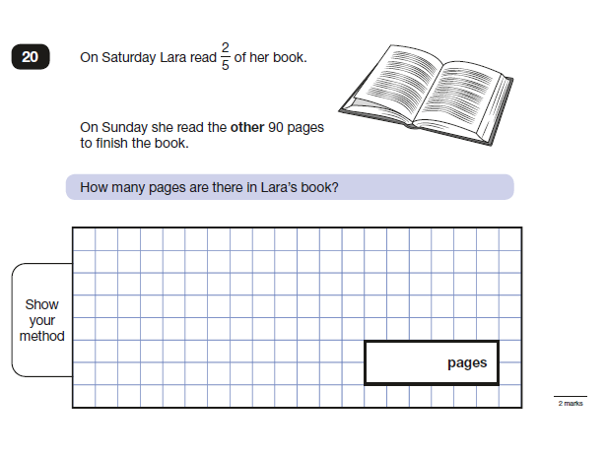
Sample Ks2 maths reasoning questions
Notes:
J

Slide 24
How to support your child with maths
Support them to practise their times tables.
Formal method for the four operations practice: it is important your child can complete methods accurately. (Methods for year 6 child: column addition, column subtraction, short multiplication, long multiplication, short division, long division including expressing remainders as fractions, decimals and remainder form)
Arithmetic speed practice
(see our calculation policy- https://www.droxfordjunior.co.uk/page/?title=Curriculum+support+for+parents&pid=25 )
Notes:
J

Slide 25
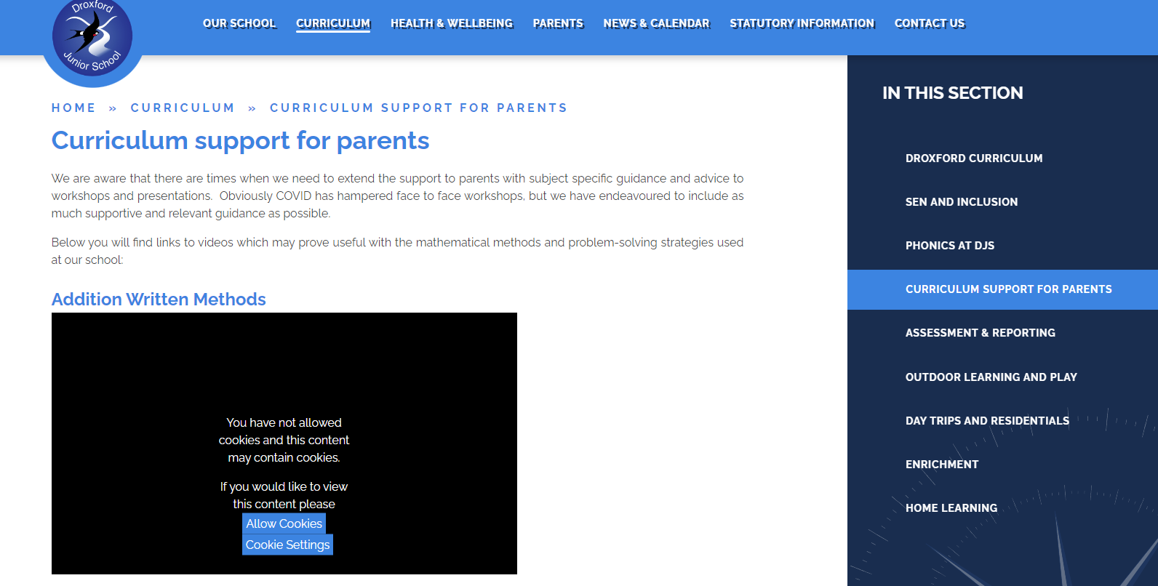
Notes:
J

Slide 26
Writing
Teacher assessed
Can be moderated (externally)
Need to show evidence in a range of pieces/genres that they can meet ARE (Age Related Expectations.)
Tabs
Evidence gathered up until end of June (throughout play rehearsal time)
Handwriting is important but is only a small element of writing.
Editing and improving priority
Notes:
A

Slide 27
Our Top Tips
Tip 1: Remember your child’s education is a partnership. Meet with their teachers as they will know your child's strengths and weaknesses, and ask them how you can help.
Tip 2: Support your child with homework tasks and daily reading. Try drawing or acting-out answers of difficult concepts.
Tip 3: Encourage your child to work to speed. Try timed recall of times tables in the car/journey to school. Set mini challenges for example – ‘can you find the word on the page that means ‘dangerous’ you have 1 minute - go!’ ‘What is 10% of 150? You have 10 seconds - go!’
Tip 4: Make sure your child is aware that getting stuck is not a problem. Move on and give them another challenge and come back to the hard ones at the end and/or go through it together.
Tip 6: Remind your child that the tests are important, but that they are not the only way they are to be measured. We don’t want child panicking or worried, we want them to be prepared.
Tip 7: Approach a subject from lots of different angles. Software, games, activities, books, flash cards and practical applications all help? make the revision time at home as fun and interactive as possible.
Tip 8: It is easier said than done, BUT do not put your child under too much pressure. Have fun – they will find things easier to remember if they recall the good times they had learning.
Notes:
B

Slide 28
Questions?

