Slide 1


Maths at
Droxford Junior School

Slide 2
Maths at Droxford Junior School
Aims of this meeting:
Our Curriculum
How Maths is taught at Droxford Junior School (and some strategies we use)
Written Methods and Our Calculation Policy
Assessments
How to Help Your Child With Maths

Slide 3
1. Our Curriculum
The national curriculum for mathematics aims to ensure that all pupils:
become fluent in the fundamentals of mathematics so that pupils develop conceptual understanding and the ability to recall and apply knowledge rapidly and accurately
reason mathematically by following a line of enquiry, conjecturing relationships and generalisations, and developing an argument, justification or proof using mathematical language
can solve problems by applying their mathematics to a variety of routine and non-routine problems with increasing sophistication, including breaking down problems into a series of simpler steps and persevering in seeking solutions

Slide 4
Our aims are to ensure that all pupils become proficient with:
Fluency
Reasoning
Problem Solving

Slide 5
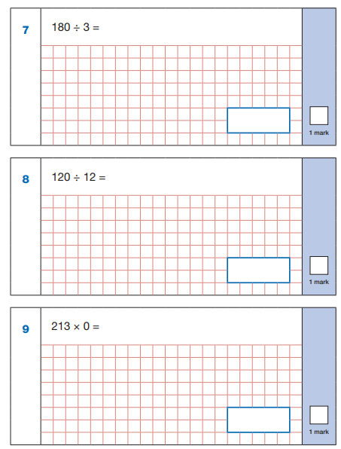
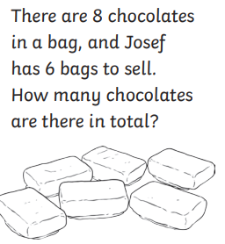
Fluency

Slide 6
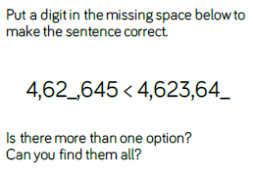
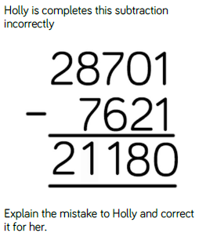
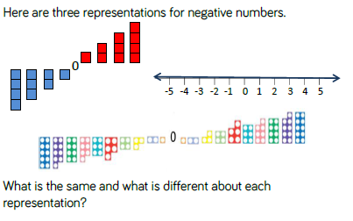
Deepening the learning
Reasoning

Slide 7
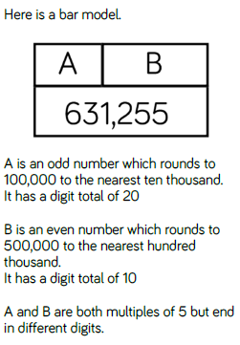
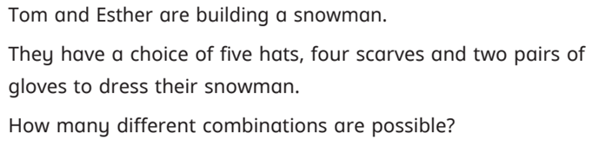
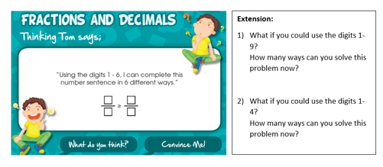
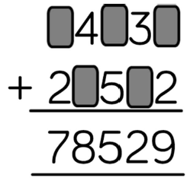
Deepening the learning
Problem Solving

Slide 8

Learning Approach

Slide 9
2. How Maths is taught at Droxford Junior School
Maths is taught each morning for 1 hour.
Maths is not ‘set’ – all children are taught in a mixed ability setting, with teachers using effective AfL to tailor learning to each child.
Sometimes, classes are split dependent on need:
-Year group specific learning objectives
-Gaps and ‘mop ups’
-Stretch and challenge

Slide 10
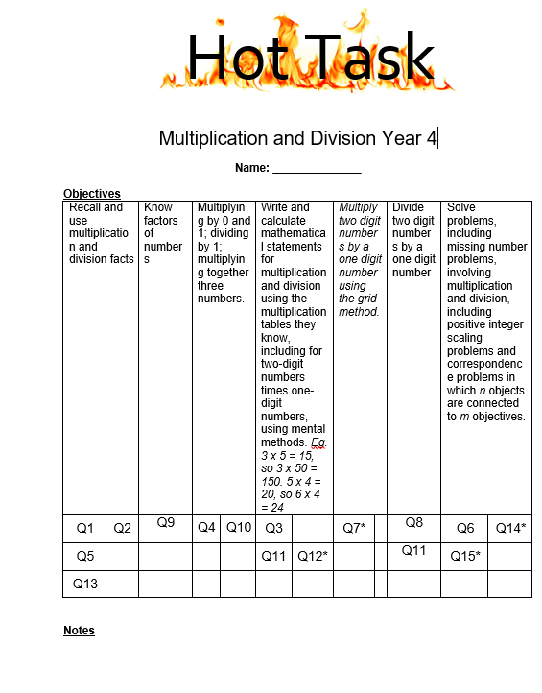
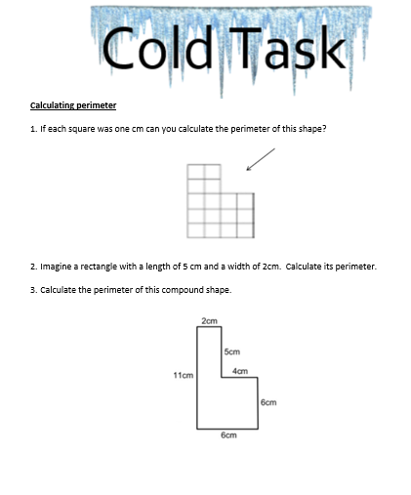
Providing a challenge for all learners

Slide 11
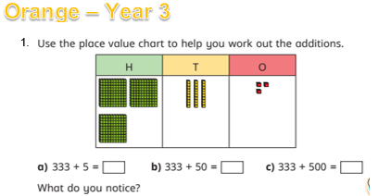

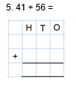
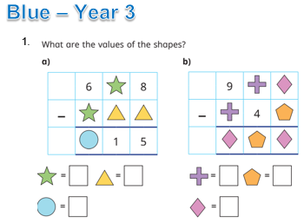
Providing a challenge for all learners
3 levels of challenge
Year 3 and 4

Slide 12
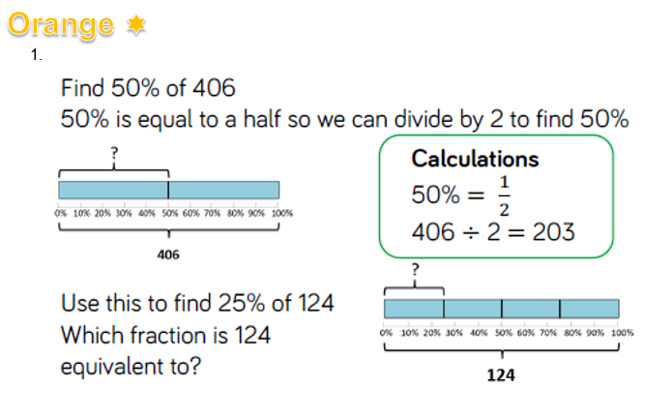
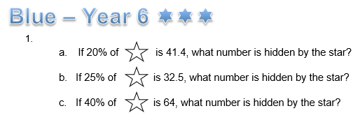
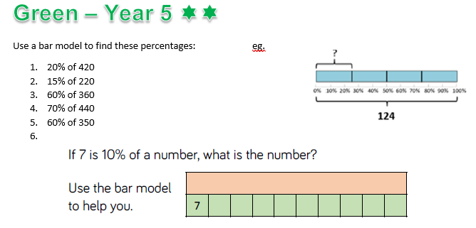
Providing a challenge for all learners
3 levels of challenge
Year 5 and 6

Slide 13
What a Maths lesson looks like
Marking in Maths
Mops Up Groups
Fast 5 or recapping
Cutaway groups
Small group work
Boosters and interventions

Slide 14
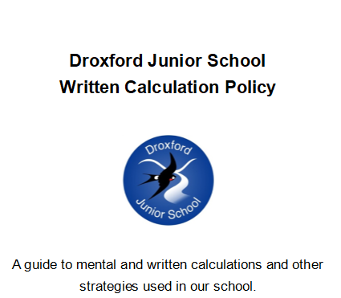
3. Written Methods and our Calculation Policy

Slide 15
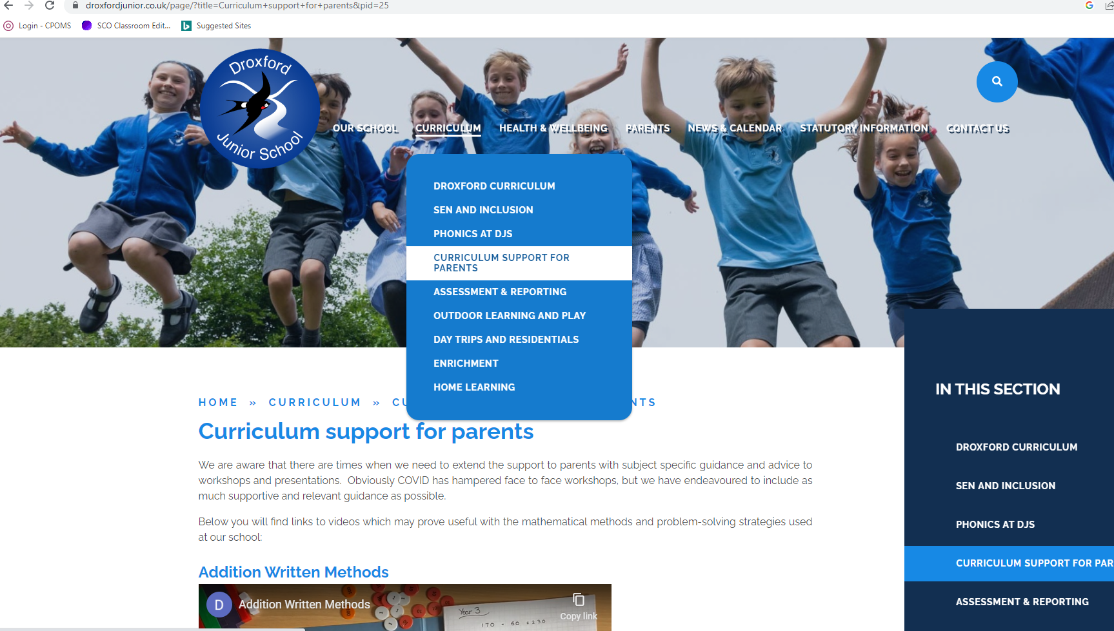
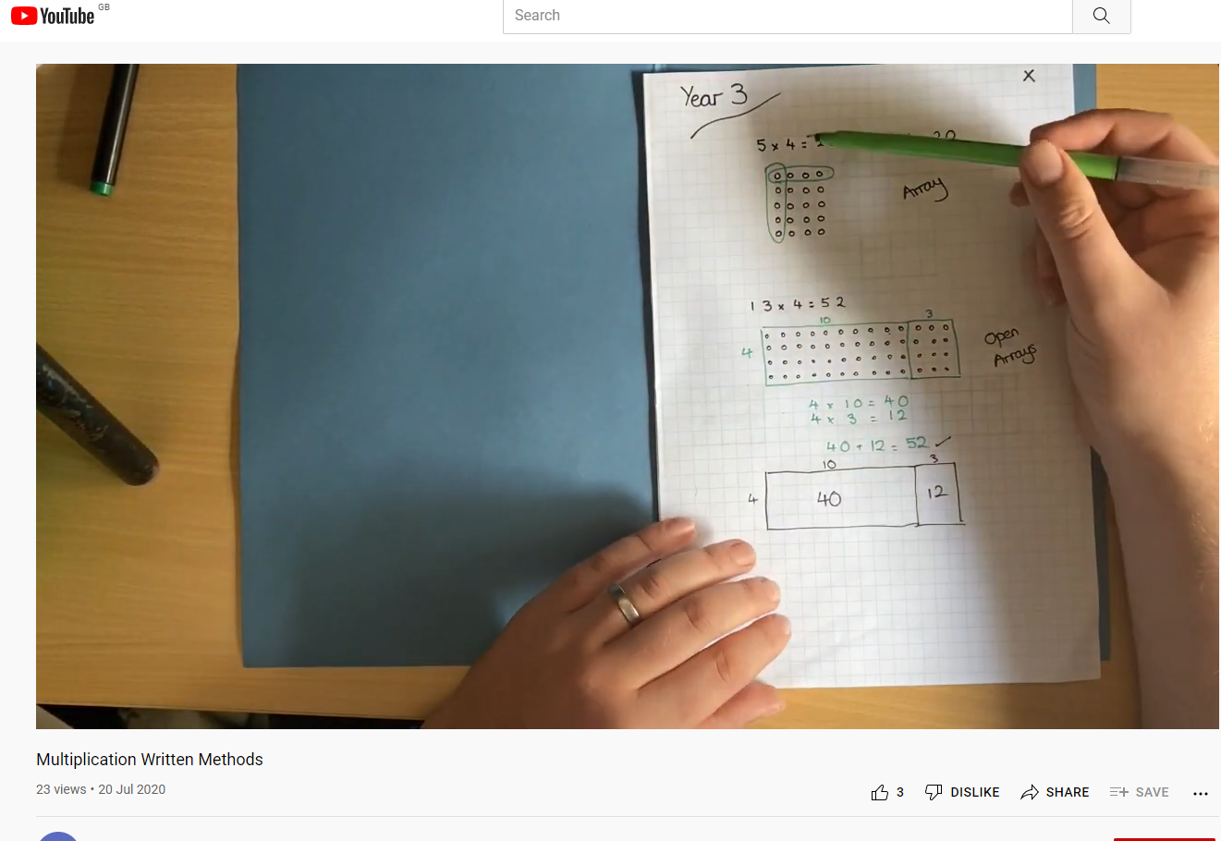
Videos
Videos which work through examples of our written methods (and some problem solving) can be found on this tab.

Slide 16
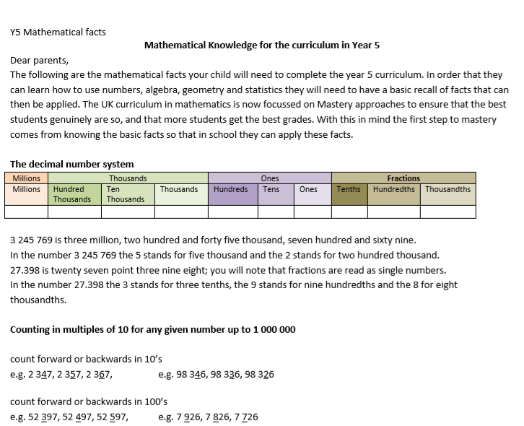
Mathematical Knowledge Handouts

Slide 17
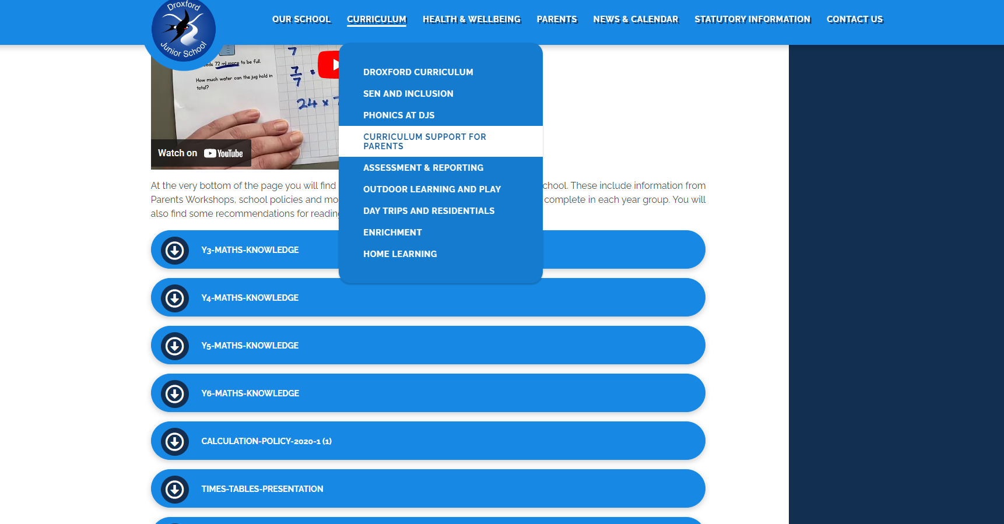
Policies and Handouts
Every policy and handout mentioned today can be found on the school website!
Look at the Curriculum tab and click on Curriculum support for parents

Slide 18
Assessments: at the End of Year 6
Children will sit three papers in maths:
Paper 1: arithmetic, 30 minutes
Papers 2 and 3: reasoning, 40 minutes per paper
Paper 1 will consist of fixed response questions, where children have to give the correct answer to calculations, including long multiplication and division. Papers 2 and 3 will involve a number of question types, including:
  Multiple choice
  True or false
  Constrained questions, e.g. giving the answer to a calculation, drawing a shape or completing a table or chart
  Less constrained questions, where children will have to explain their approach for solving a problem

Slide 19
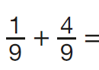
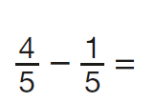
Sample KS2 maths arithmetic questions
6.1 + 0.3 =
5 × 4 × 7 =
4² =
1,440 ÷ 12 =
630 ÷ 1/9 =
1,034 + 586 =
86% of £324 =
2.5 + 0.05 =
24 × 3 =
100 × 100 =
48 ÷ 6 =
1.28 × 100 =

Slide 20
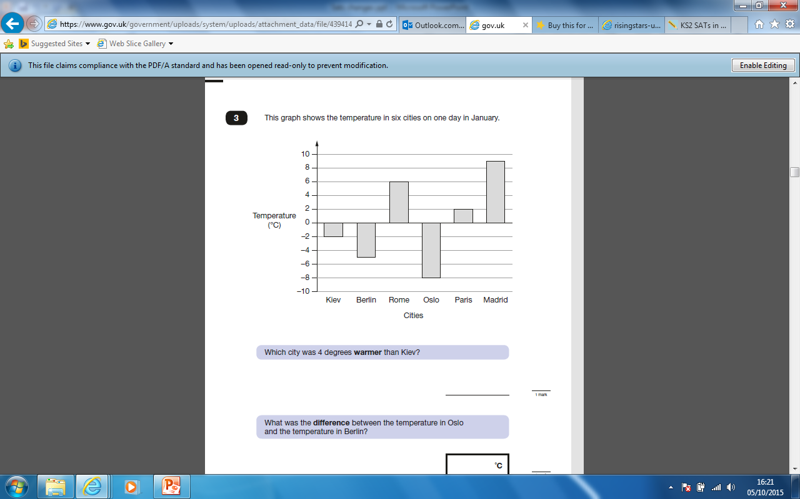
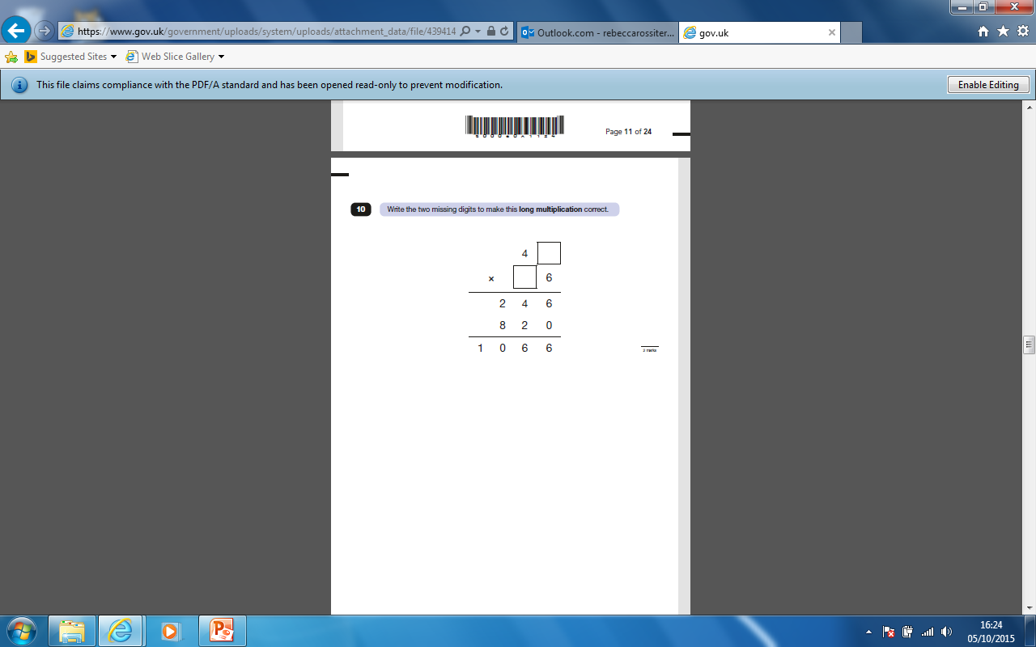
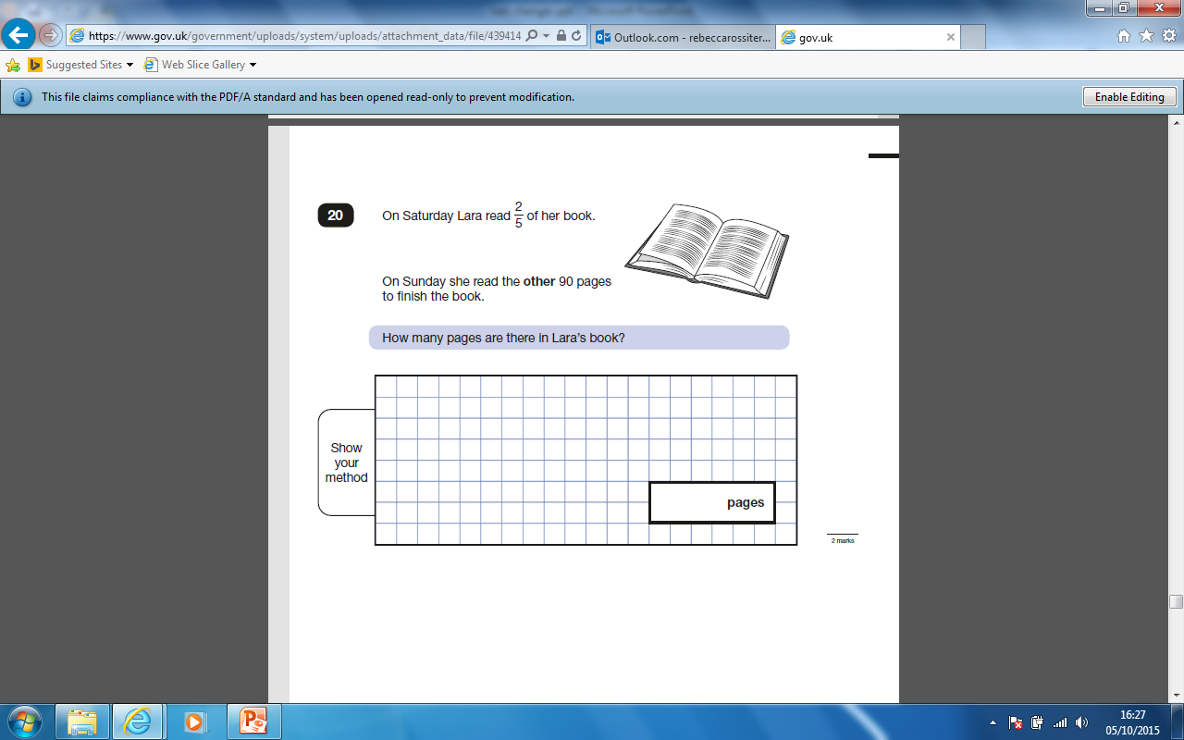
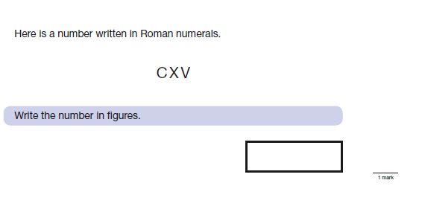
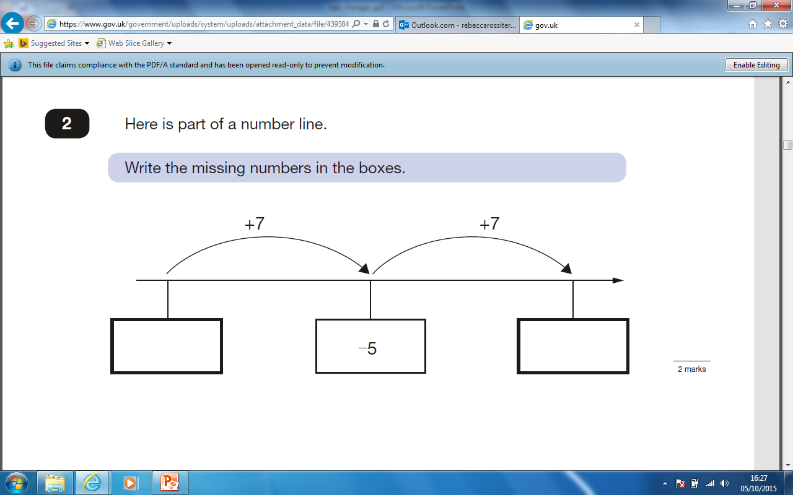
Sample KS2 maths reasoning questions

Slide 21
Assessments at Droxford
Every year, children will sit assessments in the Spring and Summer Terms.
These will be used partially for summative assessments (Reports) but also as formative assessment tools.

Slide 22
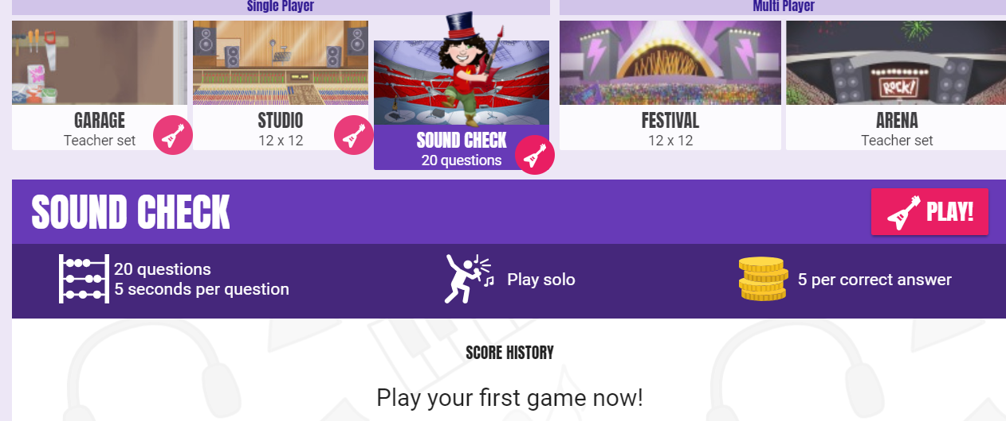
Year 4 Times Table ‘Check’
Children in year 4 will be required to take part in a times table check in the summer term – this is to check whether they can rapidly recall all of their times tables (to x12).
It will be an online test: each question will be displayed for 5 seconds on the screen and children will be required to type in the answer. It will then move on to the next question (children will not be able to return to a question if they miss it out).
TT Rockstars:
Use ‘Sound Check’ mode which will
replicate this set up.

Slide 23
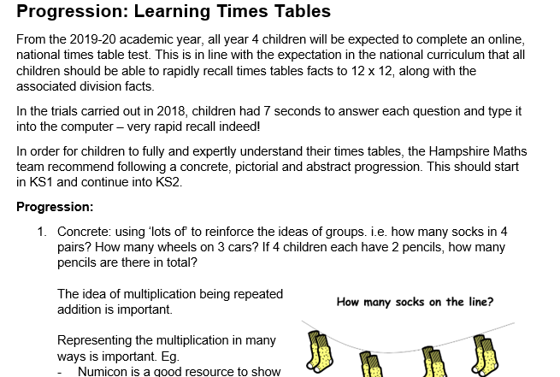
Progression in Times Tables Document

Slide 24
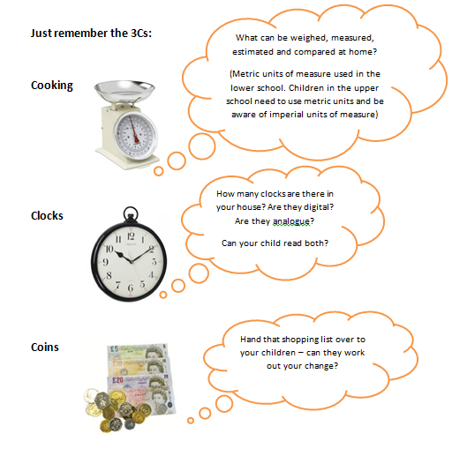
5. How to support your child with maths

Slide 25
How to support your child with Maths
Homework
Please continue to help your children with their homework – taking time to sit down with your children helps to demonstrate the importance of learning!

Slide 26
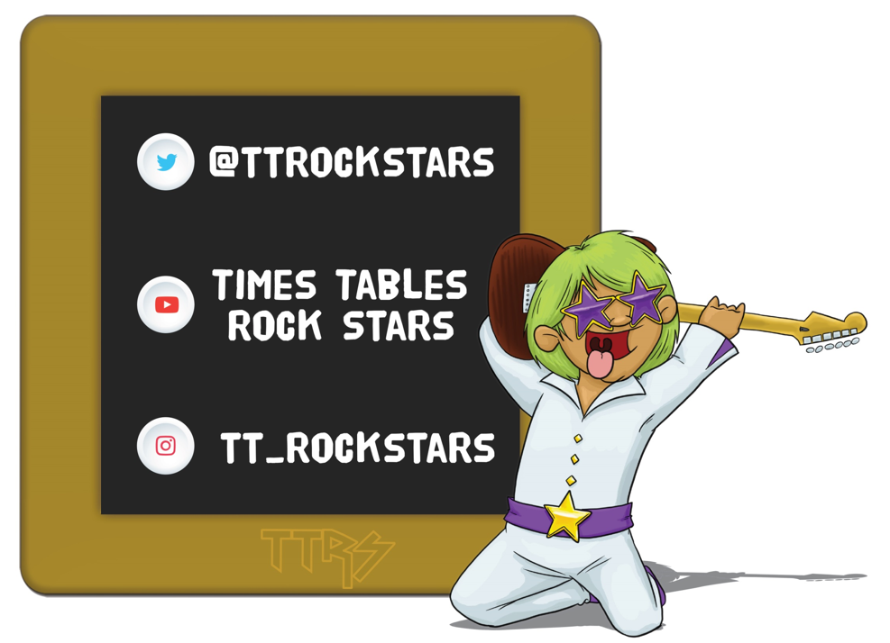
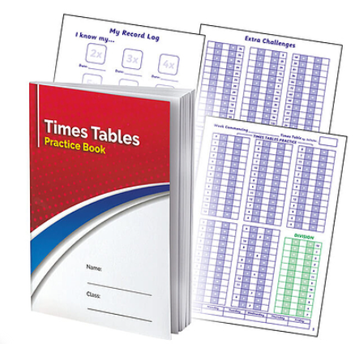
How to support your child with maths

Slide 27
Questions ?
adminoffice@droxford.hants.sch.uk
J.Smith@Droxford.hants.sch.uk
or contact your class teacher

